Slide 1
AUTO TEXT SUMMARIZATION (MP3 REVIEW 1)
-Rutva Patel (16BIT129)

Slide 2
Types of Summarizations:
Form: extract / abstract
Dimensions: single / multi-document
Context: query-specific / independent
Purpose: indicative / informative / critical
EXTRACT FORM (Statistical / IR based Approach )
Operate at lexical level, use word frequencies, similarity measures and then applies page ranking algorithm.
(B) ABSTRACT FORM (NLP / IE based Approach )
Try to “understand” text. Needs rules for text analysis and manipulation.
Higher quality.

Slide 3
(A) Statistical / IR based Approach
Word-frequency Information (very ineffective individually)
Length of the sentence (avoiding too long and short sentences, also ineffective individually)
Using Cue words (Positively correlated and Negatively correlated)
Document Structure (by giving scores to each position)
-Information from Structure (Title words, Sections etc)
-Information from Position (Genre, first or last sentence of para)
Heading Similarity/Title Similarity
Sentence to Sentence Cohesion (ratio of the sum of the similarity value(SSS) of sentence i to the Max(SSS))
Graph Based Methods
- Similarity Measures: tf-idf
- Graph G (V,E)
V: set of sentences
E: similarity between sentences > threshold

Slide 4
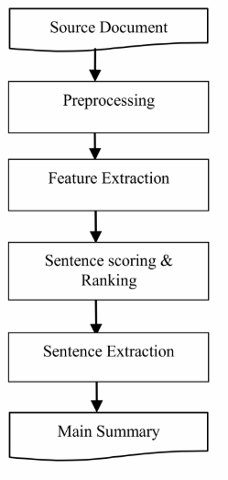
Degree of Centrality
-Rank sentences by their degree
-Pick top k as summarizing sentences
-Sensitive to distortion by 'rogue' sentences
Sentence Clusters based on Similarity
LexRank
-inspired by page rank algo.
-Value connections from highly connected neighbours
-Random Markov Walk over the graph
-LR(u)= ∑ LR(v) / dig(v)
where v is a neighbour of u
Sentence scoring is done on adding all the above features mentioned

Slide 5
(B) NLP / IE based Approaches
(1) Rhetoric based Summarization
-Rhetoric Relation
Between two non overlapping spans of text
Nucleus : core idea
Satellite : arguments to favour core idea
-Rhetoric relation is a relation between Nucleus and Satellite.
E.g. Justification, elaboration, contrast, evidence, etc

Slide 6
Summarization Method:
Generate Rhetoric Structure Tree
-Because of rhetoric ambiguity there are multiple trees
Pick best tree using
-Clustering-based metric
-Shape-based metric etc.
Pick up top K nodes nearest to the root, where K is no. of sentences expected in summary

Slide 7
(2) Wordnet based Summarization
(i) Pick up a subgraph of wordnet
Mark each word in wordnet
Traverse hyperymy direction up to suitable level and mark intermediate nodes
Mark synsets
(ii) Ranking Synsets
R : Vector of nodes in subsidized wordnet graph
A : Square matrix of size |R|x|R|
A[i][j] = 1/predecessors(j) if j is descendant of i
= 0 otherwise
Repeat R_new = R_old * A /| R_old*A | until R_new becomes small enough

Slide 8
(iii) Sentence Selection
Matrix R : sentences Vs nodes of subsidized wordnet
R[i][j] = R[j] if node j of graph is reached from words of sentences of sentence i
= 0 otherwise
(iv) PCA
Take eigen value decomposition of matrix R
Order eigen vectors on decreasing value of its corresponding eigen values
Project sentences on eigen vectors
Pick up top N_sentences sentences for particular eigen vector based on their projection on that eigen vector
Where N_sentences = λ(i)/ ∑ λ(j) * N

Slide 9
Criteria for Summary Evaluation
Fluency / coherence
Informativeness
Compression ratio

Slide 10
NEED
1. News articles
2. Email summary
3. Information summary for businessman
4. Research paper summary
5. Medical field for tracking patient’s medical history for further treatment
6. Time constrains restricts us from consuming all the data available
7. Maintaining coherence and semantics
APPLICATIONS:
1. Search engine
2. Business analysis
3. Market review

